Slide 1
Corporate Briefing Session
December 10, 2020

Slide 2
Brief Overview
Habib Insurance is one of the oldest insurance companies in Pakistan.
It was established in Bombay in 1942 and moved its Head Office to Karachi in 1947.
Over the years, the company has continued to prosper, serving its honorable clientele by maintaining a culture of integrity & trust. Habib Insurance offers a range of general insurance services including Property, Marine, Motor, Engineering & Travel. The Company celebrated its 75 years in 2017 and is one of the oldest running business of the Habib Group.

Slide 3
Management Information
Board of Directors
Rafiq M. Habib | Chairman
Abbas D. Habib | Director
Mansoor G. Habib | Director
Muhammad Hyder Habib | Director
Qumail R. Habib | Director
Aun Mohammad A. Habib | Executive Director
Shahid Ghaffar | Director
Ali Fadoo | Director
Maleeha Humayun Bangash | Director
Shabbir Gulamali | Chief Executive
Murtaza Hussain | Chief Financial Officer
Muhammad Maaz Akbar | Company Secretary
Audit Committee
Shahid Ghaffar | Chairman
Mansoor G. Habib | Member
Qumail R. Habib | Member

Slide 4
Management Information
Ethics, Nomination, Human Resource & Remuneration Committee
Ali Fadoo | Chairman
Rafiq M. Habib | Member
Abbas D. Habib | Member
Aun Mohammad A. Habib | Member
Investment Committee
Shahid Ghaffar | Chairman
Mansoor G. Habib | Member
Qumail R. Habib | Member
Maleeha Humayun Bangash | Member
Shabbir Gulamali | Member
Murtaza Hussain | Member
Auditors
KPMG Taseer Hadi & Co., Chartered Accountants

Slide 5
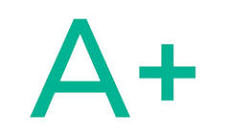
Credit Rating
PACRA Ratings
December 03, 2020

Slide 6
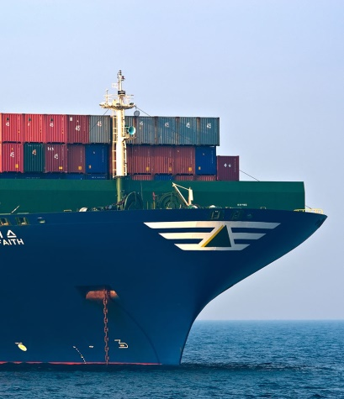
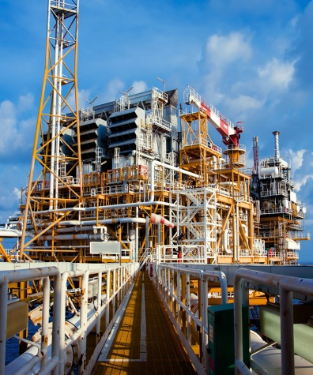
Our Products
Property
Marine
Motor
Engineering
Travel
Miscellaneous

Slide 7
Awards & Recognitions
Twelve times ‘Top 25 Companies Award’ by Pakistan Stock Exchange (Former Karachi Stock Exchange) including for eight consecutive years from 1979 to 1986 and for the years 1993, 1995, 1997 and 2014.

Slide 8
Economy
6 Month KIBOR
PKR/US$
GDP Composition
GDP Growth

Slide 9
Pakistan Insurance Sector, CY19
Given the economic slowdown, the core function of the sector suffered with limited Net Premium growth, whereas claim ratio too deteriorated. The Investment Income - historically driven by stock market performance - found support from fixed income segment (due to declining interest rate scenario);
Rs Bn | 2019 | 2018 | YoY
Net Insurance Premium | 40.71 | 39.14 | 4.0%
Net Insurance Claims | 20.27 | 19.34 | 4.8%
Net Commission Income | 2.59 | 1.77 | 46.3%
Management Expenses | 14.24 | 13.03 | 9.3%
Underwriting results | 3.61 | 5.12 | -29.4%
Investment & Other Income | 9.94 | 7.65 | 29.9%
Other expenses | 1.12 | 1.19 | -5.8%
Profit Before Tax | 12.64 | 12.06 | 4.8%
Profit After Tax | 9.66 | 8.01 | 20.6%

Slide 10
Financial Snapshot-9MCY20
PKR Million (Except per share) | 9MCY20 | 9MCY19 | YoY
Gross insurance premium/ Contribution | 1,264.15 | 1,236.64 | 2.22%
Underwriting results | 91.35 | 62.14 | 47.01%
Investment & Other Income | 40.79 | 87.24 | -53.25%
Profit After Tax | 27.57 | 53.12 | -48.10%
Paid Up Capital | 619.37 | 619.37 | 0.00%
Reserves & Retained Earning | 614.70 | 629.81 | -2.40%
Total Assets | 4,018.43 | 3,640.67 | 10.38%
DPS | - | - | -
Stock Dividend | - | - | -

Slide 11
Business Review-9MCY20
P&L (PKR Million) | 9MCY20 | 9MCY19 | YoY
Net insurance premium | 559.56 | 561.93 | -0.42%
Net Insurance Claim | 291.86 | 318.52 | -8.37%
Net Commission Income | 59.01 | 33.95 | 73.84%
Management expenses | 235.36 | 215.22 | 9.36%
Underwriting results | 91.35 | 62.14 | 47.01%
Investment & other Income | 40.79 | 87.24 | -53.25%
Other expenses | 81.33 | 79.52 | 2.27%
Results of operating activities | 50.81 | 69.86 | -27.28%
Financial charges | 13.40 | 10.33 | 29.70%
Profit before tax from General Insurance Operations | 37.41 | 59.53 | -37.17%
Profit before tax from Window Takaful Operations - Operator’s Fund | 2.11 | 6.61 | -68.15%
Profit before tax for the period | 39.51 | 66.15 | -40.26%
Profit after tax for the period | 27.57 | 53.12 | -48.10%

Slide 12
Business Review

Slide 13
Business Review

Slide 14
Corporate Payouts
Year | Cash | Bonus
2019 | 10% | -
2018 | 15% | -
2017 | 15% | -
2016 | 35% | -
2015 | 35% | -
2014 | 40% | -
2013 | 25% | 25%
2012 | 35% | -
2011 | 25% | 10%
2010 | 25% | 12.50%

Slide 15
Future Outlook: CY20
Focus on growth with cautious underwriting and increase in underwriting profit
Being conservative on equity market
More reliance on fixed income securities

Slide 16
Thank You
Q&A

